Slide 1
Midterm Presentations:
Team 5-Rajat Agarwal, Ankit Bhayani, Vishakha Sawant

Slide 2
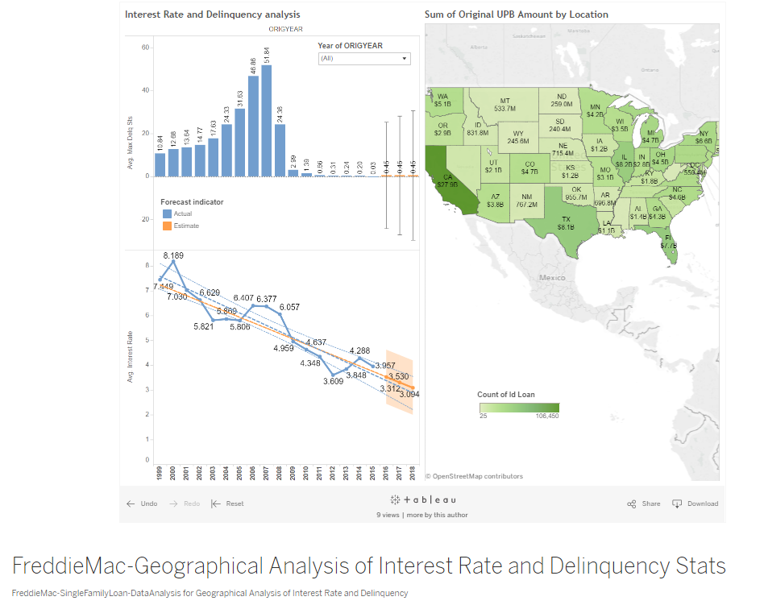
Part I: Data wrangling

Slide 3
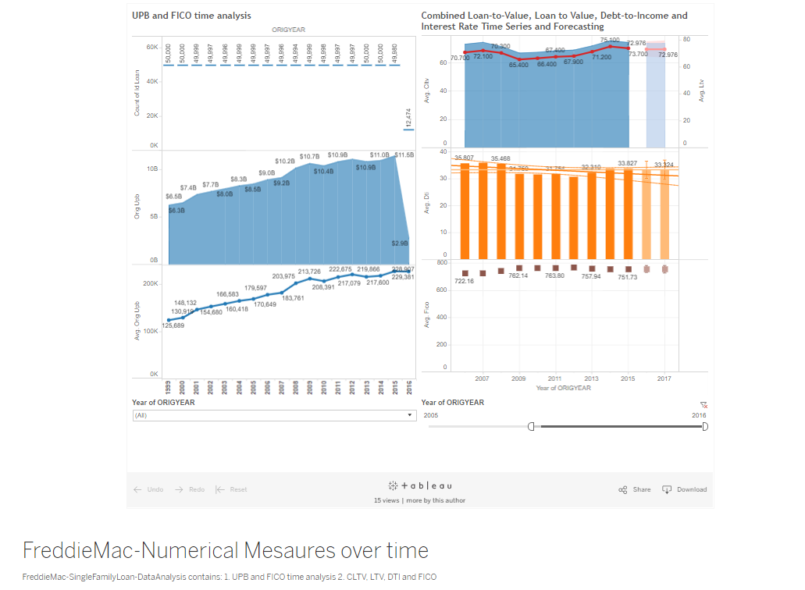

Slide 4
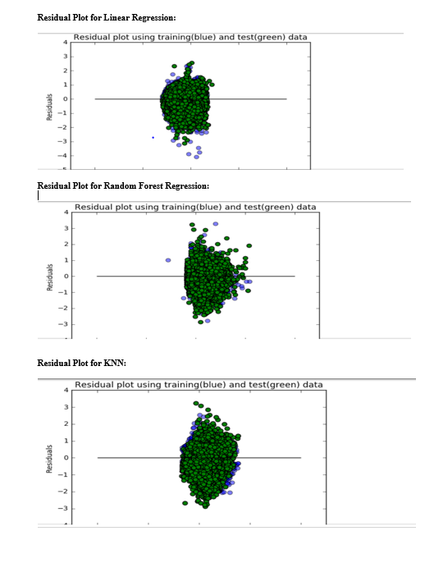
Part II: Building and evaluating models Prediction:

Slide 5
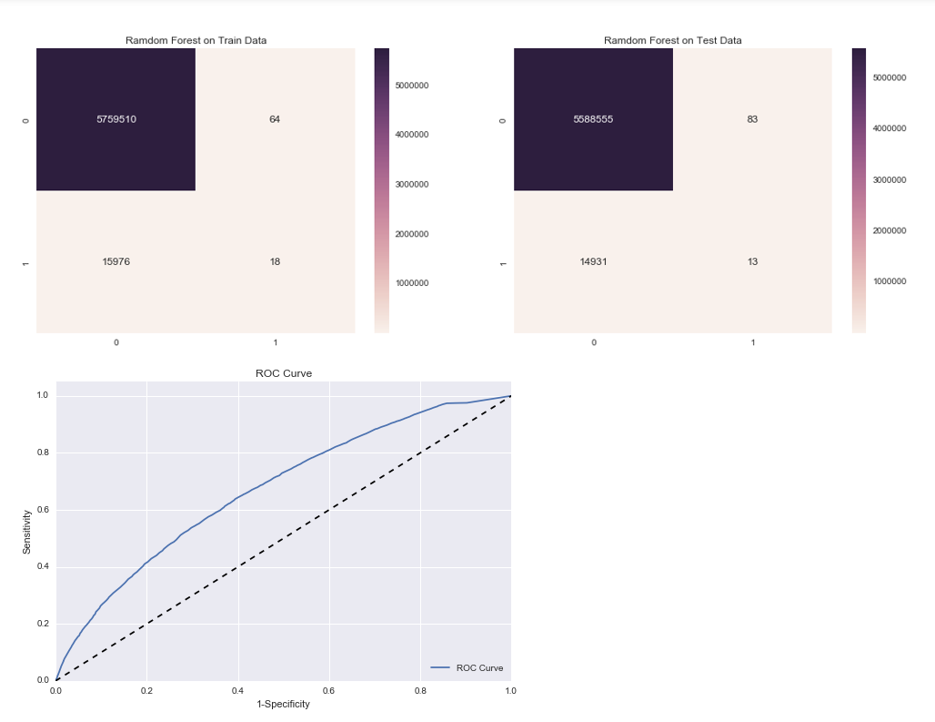
Classification:

Slide 6
Contributions:

Slide 7
Thank You.

